Slide 1


Old Dominion University
CS 411W - Team Bronze
Prototype Demo Slide Deck
April 23, 2020

Slide 2
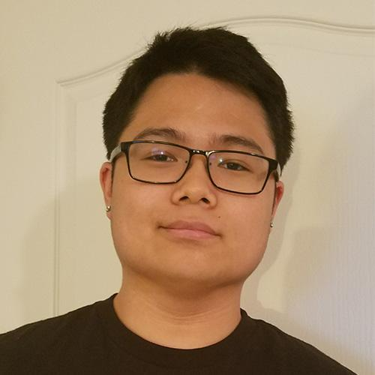

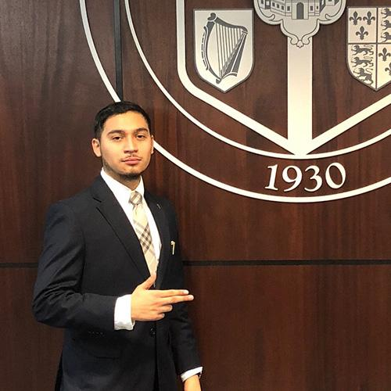
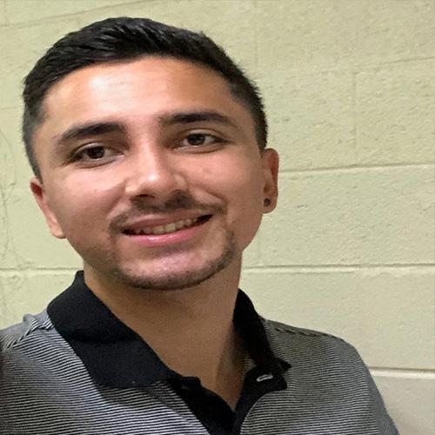

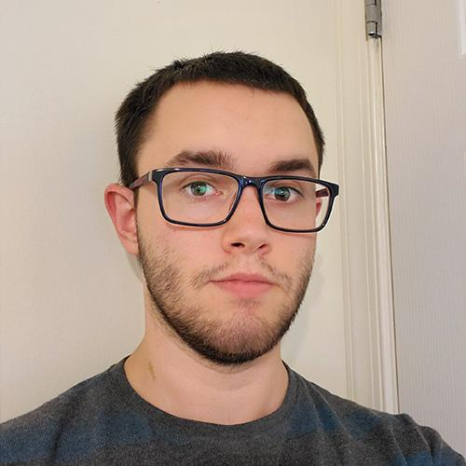

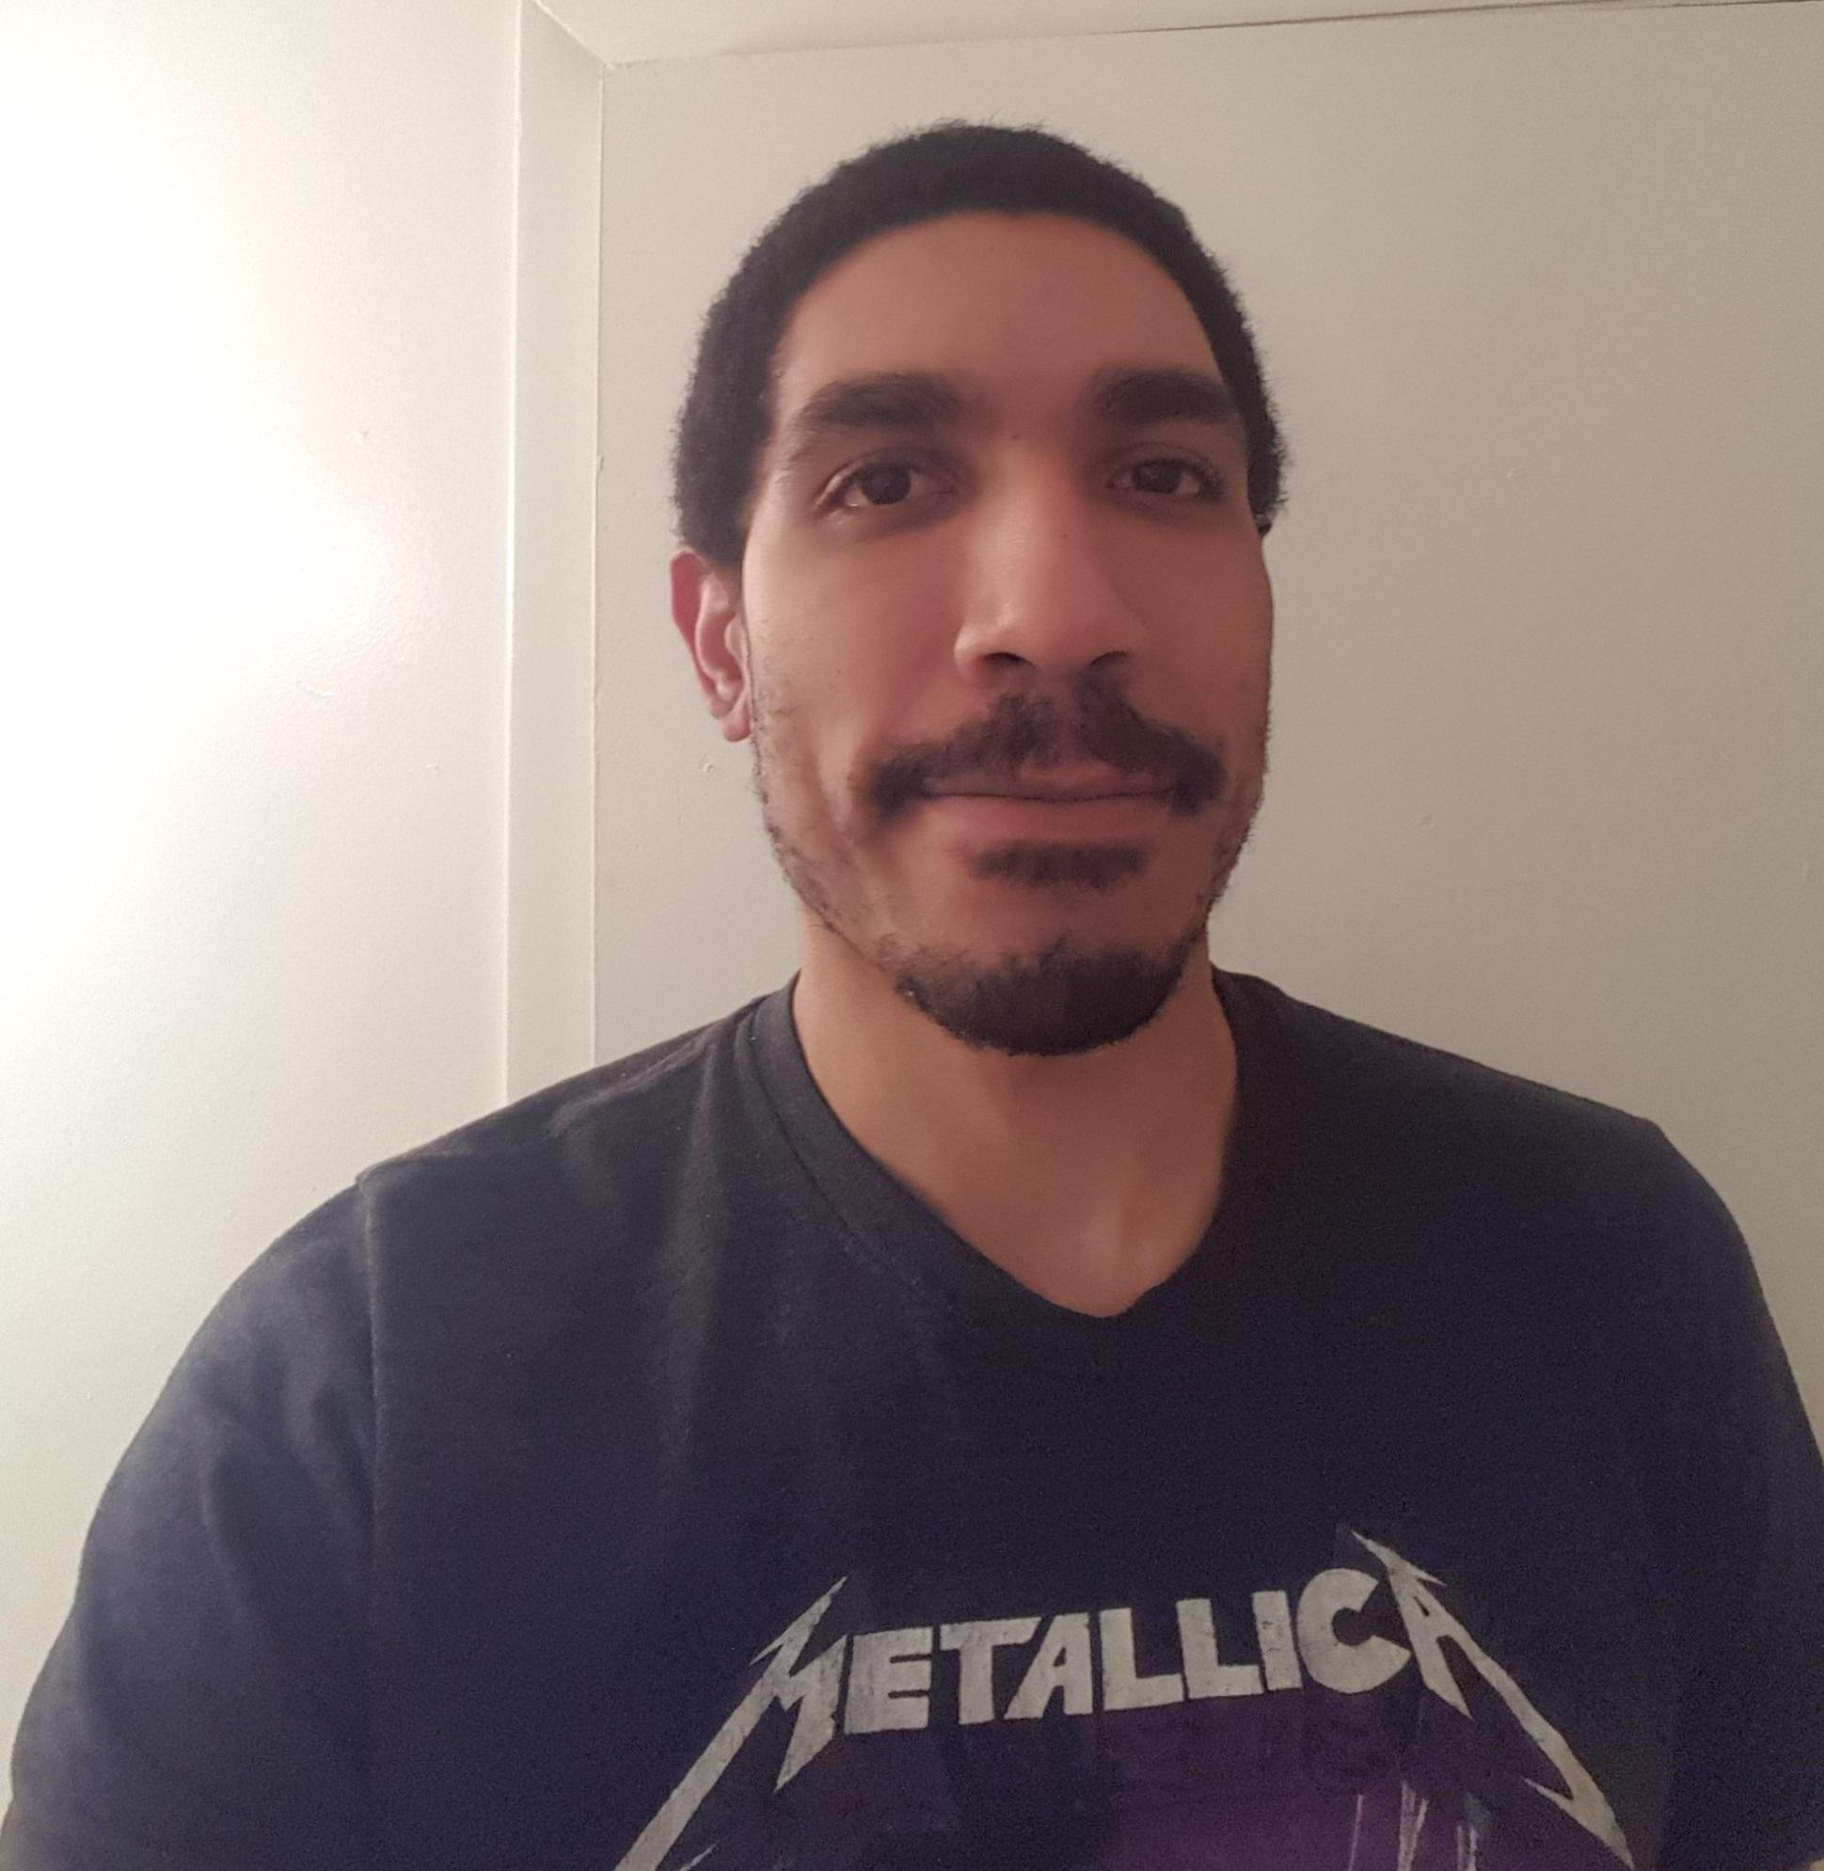
Meet the Team!
Kevin Fang
Team Lead/Lead Algorithms Designer
April McIntire
UI/UX Designer/Animator
Rodolfo Monterroso
Game Developer
Roshan Ghimire
Developer/Algorithms Designer
Josten Asercion
Lead Game Developer/Animator
Tim Novak
Lead Back-End Developer
Shane Shifflett
Webmaster
Mohammad Bashghareh
Back-End Developer
CS 411W - Team Bronze | Spring 2020 | Old Dominion University

Slide 3
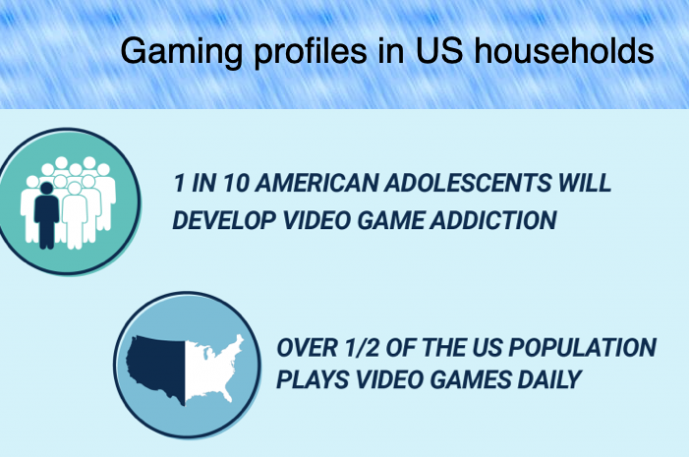
Problem Background
The World Health Organization officially claimed gaming disorder as a disease in 2018.⁹
To be diagnosed with gaming disorder, a person must show 12 months of severe symptoms, including prioritizing gaming over work, education and social relationships.⁹
64% of the U.S. Population are gamers.⁶
Globally, 75 million people suffer from gaming disorder.⁹
77% of Americans are not meeting the recommended amount of exercise by the U.S. Department of Health and Human Services ²
CS 410 - Team Bronze | Fall 2019 | Old Dominion University
Notes:
Was trying to add in-text citation, but could not find quote for
77% of Americans are not meeting the recommended amount of exercise by the U.S. Department of Health and Human Services
Either get rid or find a quote similar that we can reference
https://health.gov/dietaryguidelines/2015/guidelines/appendix-1/

Slide 4
Problem Statement
Gaming disorder disrupts normal life activities and causes important aspects of life to be neglected, such as maintaining a healthy dose of physical activity. The combination of video gaming and a lack of physical exercise leads to health concerns such as weight gain, poor posture, and an increased risk of type 2 diabetes in America's population.¹⁴
CS 411W - Team Bronze | Spring 2020 | Old Dominion University
Notes:
Changed correlation to “Often, the combination “, see about adding a citation showing correlation of video gaming, lack of exercise leads to health concerns - Kevin.

Slide 5
Customers, Users, and Stakeholders
Users/Customers
Game Addicts
Gamers (not necessarily addicts)
Exercise Enthusiasts
Stakeholders
Family and friends of game addicts
Gyms
Gold’s Gym, Planet Fitness, etc.
Personal Trainers
CS 411W - Team Bronze | Spring 2020 | Old Dominion University

Slide 6
Solution Statement
War of Brawns is a mobile application that focuses on engaging video gamers in a fantasy Role-Playing Game (RPG)⁵ where the storyline and character progression relies solely on the user’s physical activity. This will help users to incorporate healthy diet and exercise habits into their lifestyle that is being neglected due to video game addiction.
CS 411W - Team Bronze | Spring 2020 | Old Dominion University
Notes:
More detail about why the fantasy theme was chosen and is it popular?
Found this quote “The most addictive video games include massively multiplayer online games (MMOs) and role-playing games (RPGs).” in reference 5. Could be useful for argument why RPG theme was chosen.

Slide 7
Solution Characteristics
Sidetracks the long term gratification by offering instant gratification through in-game rewards and character progression.
Enforces commitment through the video game addiction. ¹
Trackers use biometrics to ensure physical activity.
Offers a variety of challenges such as gym or home workouts that can be shown based on users preference.
Application will include a workout guide for the user to understand proper form.
Track daily calorie intake through a diet journal.
Application will record progress towards goal weight through a line graph.
Offers interactive gameplay
CS 411W - Team Bronze | Spring 2020 | Old Dominion University
Notes:
Changed “short term” to “instant” because of direct relation to rewards and progression.
Go back over the solution characteristics and what the solution will not do and compare and contrast, so that all components of the app will be covered and discuss where to put missing details.
Instant Gratifcation:
leaderboard, daily streaks, and medals for accomplishment in solution characteristics.
in-game rewards and progression
combat system requires progression from user
swords, armor, etc
Stat increases
If we present again, then explain more of what the instant gratification is to the user and the designer.
If we present again, then explain that even though other applications have this feature, but we want these features to be in one whole application
Game will include “workout tutorials” in the workout challenges menu which will show general form
Put in Solution Characteristics or solution flow(?)Input information about this exercise guide into the solution characteristics and competition matrix

Slide 8
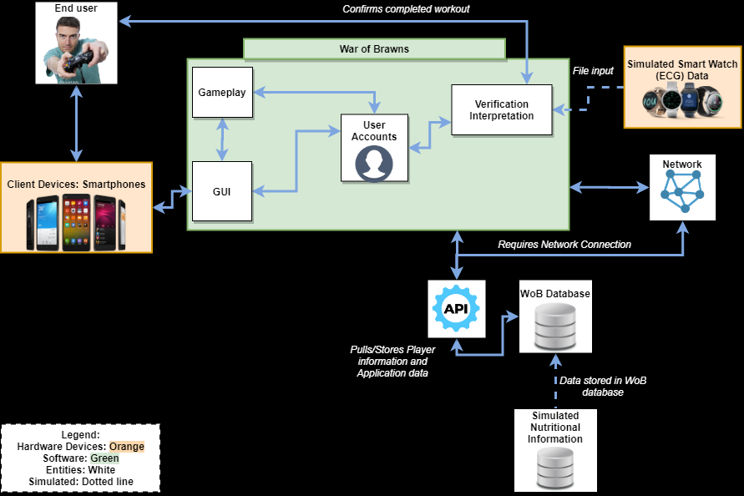
Prototype Major Functional Components Diagram
CS 411W - Team Bronze | Spring 2020 | Old Dominion University

Slide 9
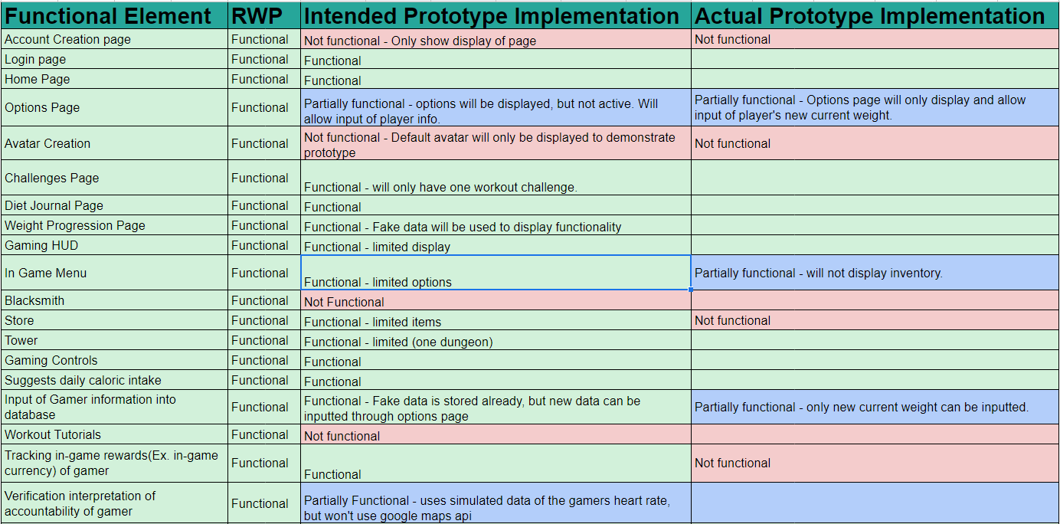
What We Accomplished
CS 411W - Team Bronze | Spring 2020 | Old Dominion University

Slide 10
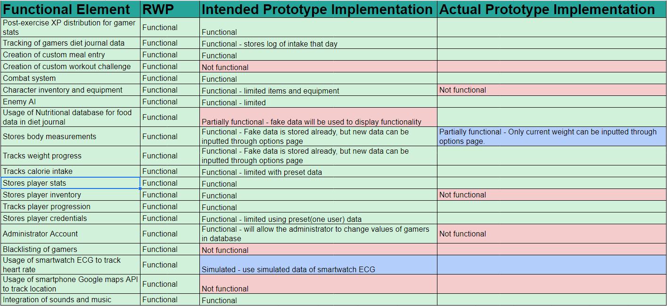
What We Accomplished (Continued)
CS 411W - Team Bronze | Spring 2020 | Old Dominion University

Slide 11
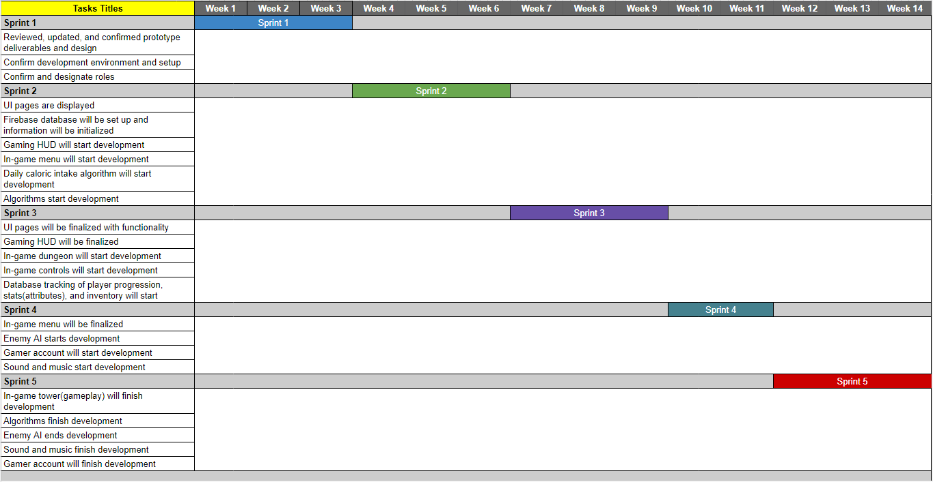
Development/Sprint Profile
CS 411W - Team Bronze | Spring 2020 | Old Dominion University

Slide 12
Risk Matrix and Mitigation Strategies
Technical Risks:
T-1: The server is unable to handle the database usage as the user base grows, performance degrades
T-2: App loses connection the Internet
T-3: Smartwatch loses bluetooth connection to smartphone
Security Risks:
S-1: Database security breach
S-2: Unauthorized access to the database
Customer Risk:
C-1: User falsified information which leads to unwanted results
C-2: Customer becomes disinterested in the app?
C-3: Customer’s established impossible goals
Mitigation Strategies:
T-1: Implement a scalable architecture for our app to handle user growth.
T-2: Data would be saved to the offline cache to be uploaded later when Internet connection is restored.
T-3: App would show a pop-up warning that notifies the user of disconnection.
S-1: Keep up-to-date modern encryption methods.
S-2: Password protected login authentication feature offered through Firebase
C-1: Trackers for exercise and warn users that false information will impede their ability to use the app effectively
C-2: Add surveys asking for feedback and recommendations from user base to continuously improve aspects of the game.
C-3: App will test the established goals against a parameters to test if achievable.
CS 411W - Team Bronze | Spring 2020 | Old Dominion University
Notes:
Key Points: 3 types of risks we foresee (technical, security, customer) [speak to what the risks are]
Got rid of “T-2: App suggests incorrect caloric intake to meet goal weight”.
Got rid of “ T-2: Verify caloric intake suggestions and perform tests on the software to ensure it has the right value. Also provide a disclaimer stating that advice given in the app does not constitute proper medical advice.”
Note: also need to change the risk matrix picture for loss of T-2.
Added “and apply concept of gaming addiction to keep users interested.” to C-2 Mitigation. To use the concept of gaming addiction to keep users entertained.

Slide 13
Challenges We Faced When Developing the Prototype
UI
Learning curve for Unity
Scaling to different screen sizes.
Algorithms
Implementing the pause, cancel, and finish features with the ECG input.
Gameplay
Implementing features using the Unity 2D Physics Engine
Understanding Unity Editor
Database
Implementing data retrieval/storage within the Firebase SDK for Unity
Understanding Firebase authentication processes within the Unity environment
CS 411W - Team Bronze | Spring 2020 | Old Dominion University

Slide 14
Summary of Demo Sequence
Test Procedures
Login page
Authentication
Progress page
Current Weight Entry
Diet Tracking
Daily suggested caloric intake
Diet Journal Entry Features
Gameplay
In-game mechanics
Workout Tracking
Workout challenges selection
Workout challenges process and result
CS 411W - Team Bronze | Spring 2020 | Old Dominion University

